Slide 1
Liver Disease and Cancers

Slide 2
Learning Objectives
Describe the roles of lipolysis and lipoprotein particles in normal lipid transport
Apply your knowledge of adipose function to describe how cholesterol and triglycerides accumulate in the liver
Describe how obesity-associated atherogenesis progresses, and how this plays a role in cardiovascular disease
Explain the progression of non-alcoholic fatty liver disease (NAFLD)
Describe the relationship between NAFLD and liver cancers
Explain the relationships between elevated liver fat and insulin resistance
Evaluate why certain cancers are tightly associated with obesity

Slide 3
Metabolically Healthy Obesity
Percent of women who are metabolically healthy at baseline, and stayed healthy over time
At 10 years how many became unhealthy
Normal Weight ~36%
Overweight ~ 50%
Obese ~60%
Overweight
Obese
Normal Weight

Slide 4
Reflection on Healthy at Any Size
“We’ve lost the war on obesity. Fighting fat hasn’t made the fat go away. And being thinner, even if we knew how to successfully accomplish it, will not necessarily make us healthier or happier. The war on obesity has taken its toll. Extensive “collateral damage” has resulted: Food and body preoccupation, self-hatred, eating disorders, discrimination, poor health, etc. Few of us are at peace with our bodies, whether because we’re fat or because we fear becoming fat.” - https://haescommunity.com/
What do you think?

Slide 5
Obesity & Liver Disease
By Paloma Tracy

Slide 6
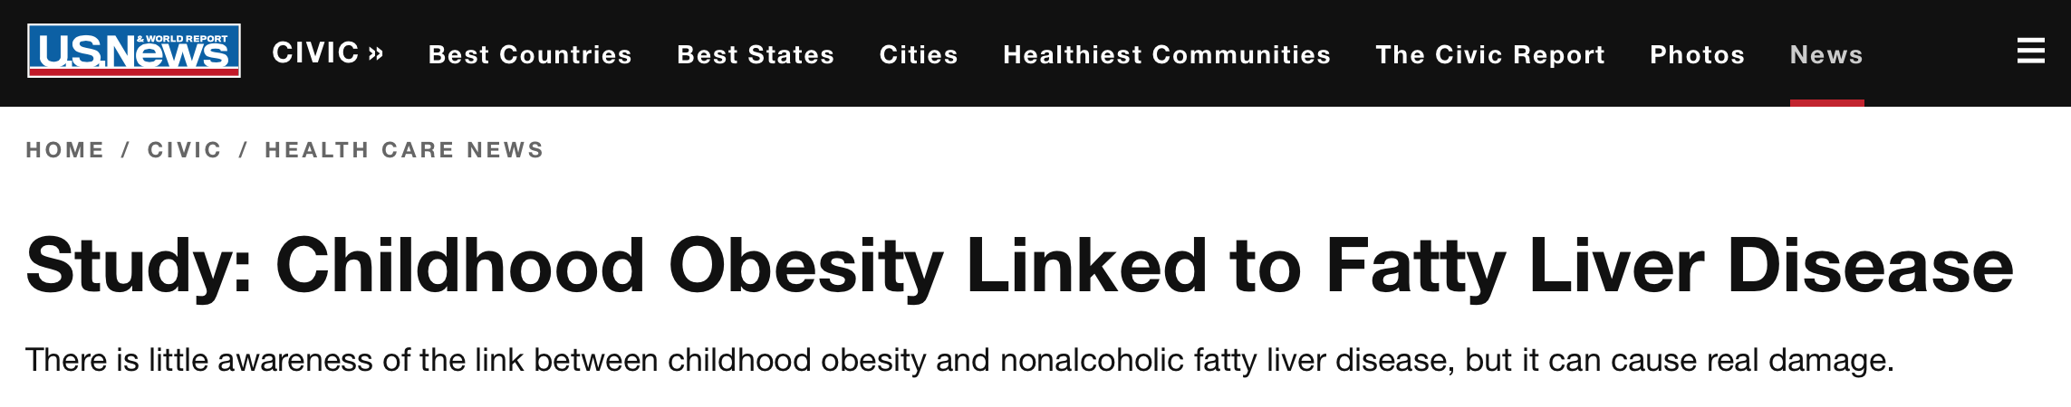
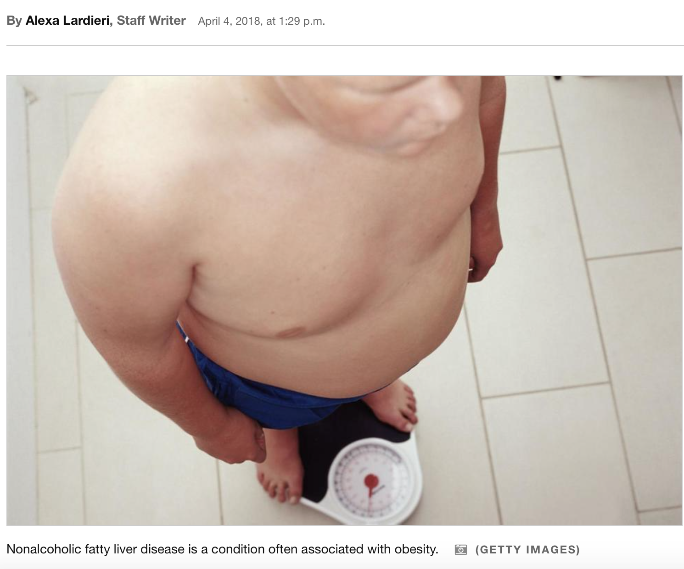
Introduction to topic

Slide 7
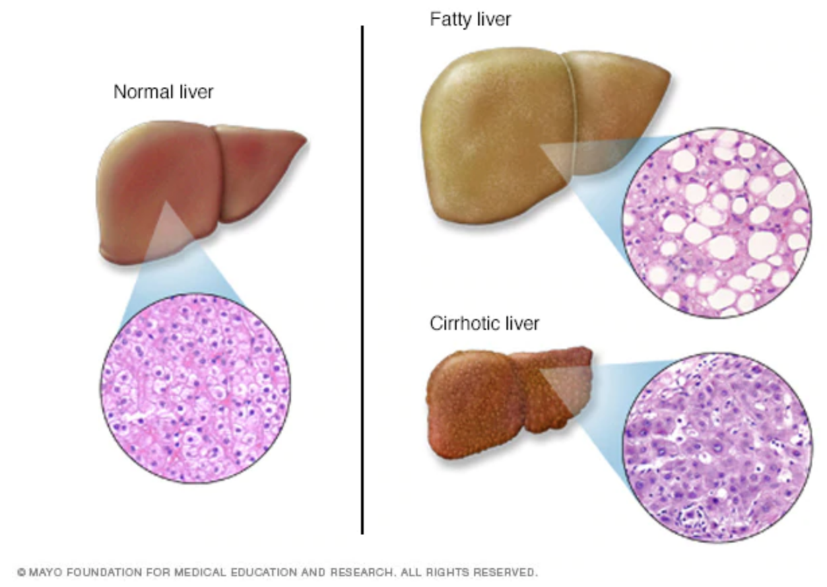
Intro: What is fatty liver disease?
NAFLD: non-alcoholic fatty liver disease
Caused by hepatic steatosis: build up of fat in liver which triggers inflammatory response and causes liver damage
Affects 80 million people in US; most common chronic liver condition among youth
Symptomless but often leads to cirrhosis (scarring of liver tissue), liver cancer, need for liver transplant
Often associated with obesity

Slide 8
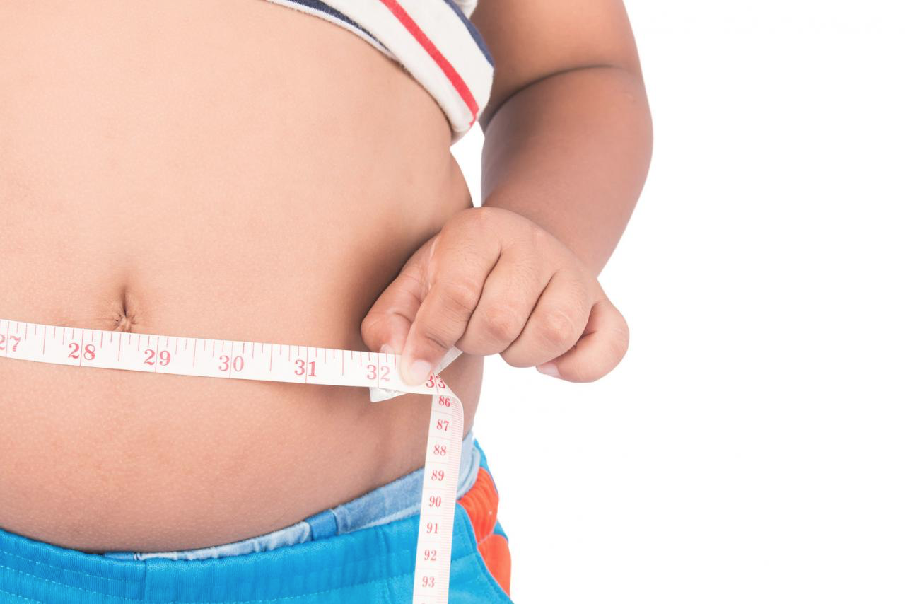
Intro: How does NAFLD relate to obesity?
“With the rise in childhood obesity, more kids are developing the disease, and we’re seeing more in our practice. Many parents are aware that obesity can lead to type 2 diabetes and other serious metabolic conditions, but there is far less awareness of the link between obesity and liver disease.”
- Dr. Jennifer Woo Baidal, MD, PhD, pediatric gastroenterologist

Slide 9
Summary of news article
Cited Dr. Woo Baidal about liver function and lack of awareness of link between NAFLD and obesity
Limited information on study
635 children
Measured waist circumference & levels of ALT - an enzyme - as a marker for liver damage at ages 3 and 8
Main findings
Children with a larger waist circumference at age 3, as well as those who had greater weight gain between the ages of 3 and 8 were more likely to have elevated ALT levels at age 8
35% of 8-year-olds with obesity had elevated ALT compared with 20% of those with normal weight

Slide 10
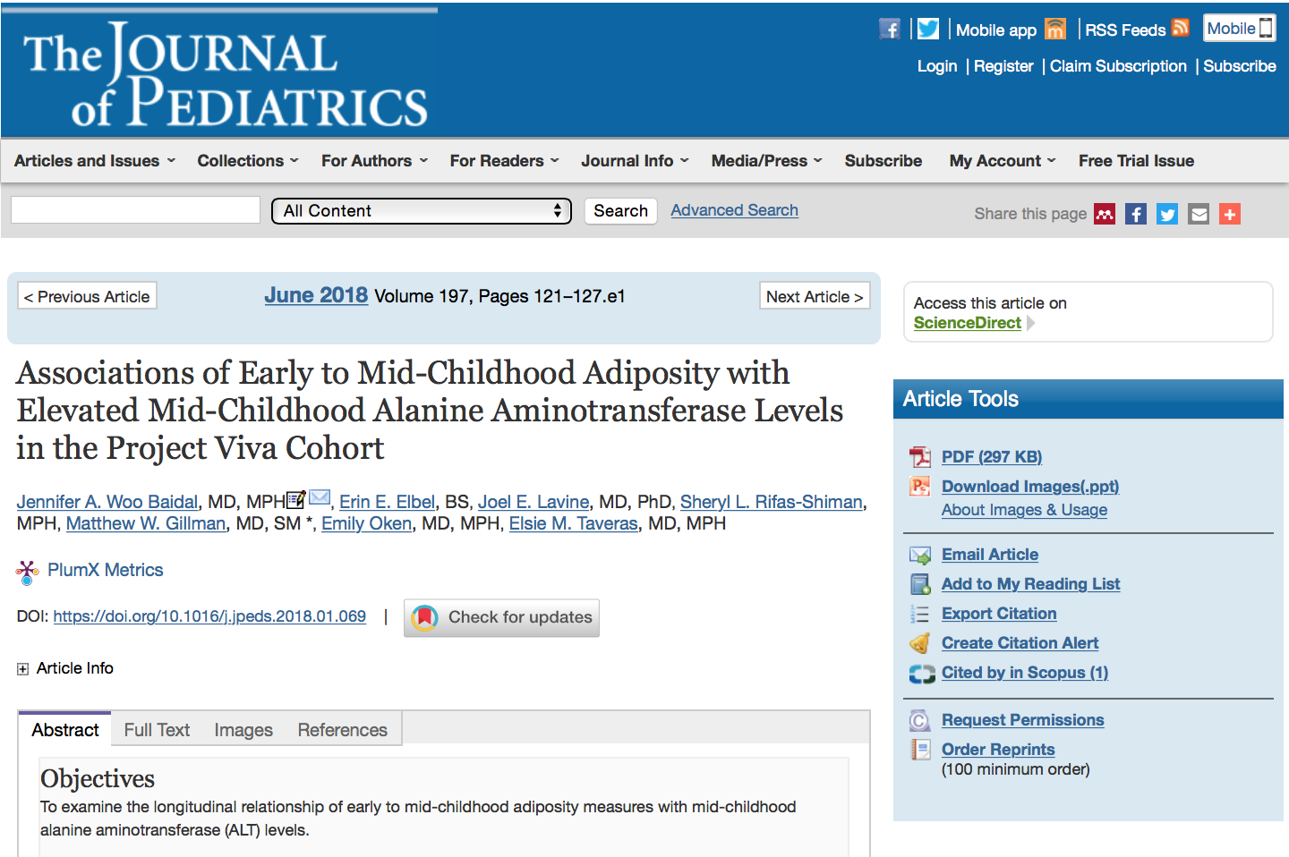
Scientific source

Slide 11
Scientific source
Study design:
Ongoing prospective pre-birth cohort study called Project Viva in which pregnant women were recruited from Atrius Harvard Vanguard Medical Associates
2128 births in the cohort, only 1708 remained enrolled - no explanation
Demographic info:
48% female, 59% white, 29% black, 6% Hispanic, 3% Asian
Participants were “more likely to be black, non-Hispanic (21% vs 15%) and less likely to be white, non-Hispanic (59% vs 66%)”

Slide 12
Scientific source
Much more information on NAFLD, ALT, relationship between adiposity measures and ALT levels among children
“At early childhood, each additional 10-cm in waist circumference was associated with 1.99 greater odds of elevated ALT at mid-childhood”

Slide 13
News article vs. scientific source
News article: “children with a larger waist circumference at age 3, as well as those who had greater weight gain between the ages of 3 and 8 were more likely to have elevated ALT levels at age 8”
Scientific article: only the relationship between waist circumference and elevated ALT levels was statistically significant

Slide 14
Public health implications
Facilitate awareness of link between childhood obesity and NAFLD
Increase focus on obesity monitoring and prevention during early-childhood
Studies on ALT levels and associated NAFLD to show correlated stages of disease
Are ALT levels / NAFLD reversible? What are the ALT level cut offs?

Slide 15
Discussion
What are the limitations of the study and how can the study be improved?
Why is there a lack of awareness of the link between obesity and NAFLD and how can we change this?
How do you think these findings should inform the monitoring, prevention, or treatment of obesity? Should they?
Notes:
Limitations: demographics are not representative, findings may not be universal or reproducible,
How to improve: alter demographics to better reflect true US child population, repeat study to assess validity
Next steps: studies on ALT levels and associated NAFLD in order to answer Qs about correlated stages of liver disease
3. Importance of obesity monitoring and prevention at early-childhood, greater focus among children (nutritious diets, PA, improve food sold at schools, length of recess/PE, limit TV time)

Slide 16
References
1. Baidal, J. A., Elbel, E. E., Lavine, J. E., Rifas-Shiman, S. L., Gillman, M. W., Oken, E., & Taveras, E. M. (2018). Associations of Early to Mid-Childhood Adiposity with Elevated Mid-Childhood Alanine Aminotransferase Levels in the Project Viva Cohort. The Journal of Pediatrics, 197. doi:10.1016/j.jpeds.2018.01.069
2. Lardieri, A. (2018, April 4). Study: Childhood Obesity Linked to Fatty Liver Disease. Retrieved from https://www.usnews.com/news/health-care-news/articles/2018-04-04/study-childhood-obesity-linked-to-fatty-liver-disease

Slide 17
Thanks!

Slide 18


Slide 19
Utilization of Stored Lipids
Used for energy
Promoted by sympathetic nervous system and stress (adrenaline and cortisol)
Blocked by insulin
What do you think would happen in insulin resistance

Slide 20
The bathtub theory of diabetes
Analogy is:
Fat :: Water
Fat Storage :: Size of Tub
Overflow :: Insulin Resistance
Insulin resistance would lead to hyperinsulinemia, beta cell compensation, etc

Slide 21
Non-Alcoholic Fatty Liver Disease (NAFLD)
Liver Diseases
Alcoholic Fatty Liver Disease (AFLD)
Non-Alcoholic Fatty Liver Disease (NAFLD)
Toxicity (Drugs, Pollutants)
Viral hepatitis
NAFLD in the US
30% have NAFLD
10.3% have advanced fibrosis

Slide 22
Progression of NAFLD
Steatosis (more fat)
Steatohepatits (fat and inflammation)
Cirrhosis (scarring)
Hepatocellular carcinoma (liver cancer)

Slide 23
How do we measure NAFLD?
Blood tests
Liver enzymes such as ALT/AST
Liver function measures such as ammonia
Non-invasive testing
Ultrasound, MRI
Elastography
Invasive
Liver biopsy and histology

Slide 24
Rates of NAFLD Progression

Slide 25
Drugs Approved to Treat Diabetes and NAFLD
Type II Diabetes
NAFLD
Repaglinide, Nateglinide
Miglitol, Acarbose
Pioglitazone, Rosiglitazone
Sitagliptin, Saxagliptin, Alogliptin, Linagliptin
Gliimepiride, Gluburide, Chlorpromade, Glipizide,
Tolbutamide, Tolazamide
Metformin
Bromocriptine
Colesvelam
Dapaglifolzin, Canaglifozin, Empagliflozin
Exenatide, Albiglutide, Dulagluditide, Liraglutide
Pralintide
Plus drug combinations (16)
Notes:
Meglitinides
Alpha glucosidase inhibitors
TXDs
DPP4 inhibitors
Sulfonylureas
Biguanides
dopamine agonists
Bile acid sequestrants
SGLT2 inhibitors
GLP1 agonists
Amylin alalog

Slide 26
Global prevalence of NAFLD

Slide 27
NAFLD-Associated Genes are Largely in the Liver and Immune System
Notes:
Hispanic at higher risk for NAFLD, but lower risk of progression

Slide 28


Topical News Assignment
Doria Weiss
PH 403 10/25

Slide 29
Obesity and Liver Disease: A Public Health Concern
Liver disease
Chronic viral hepatitis B and C
Alcoholic liver disease
Non-alcoholic fatty liver disease (NAFLD)
NAFLD affects 30% of US population
Previous research on obesity & liver disease, but unclear link between BMI and liver disease
As obesity rate is expected to increase to 1 billion by 2030, liver disease rates have increased
Unclear evidence of effect of type 2 diabetes on development of liver disease

Slide 30
High BMI Linked to Severe Liver Disease Later in Life
News article published in Medical News Today
1.2 million Swedish young male conscripted in army from 1969-1996
Longitudinal study until 2012
Research question:
Is high BMI associated with increased risk of liver disease?
Does it differ across BMI categories?
Is it partially attributed to development of type 2 diabetes?

Slide 31
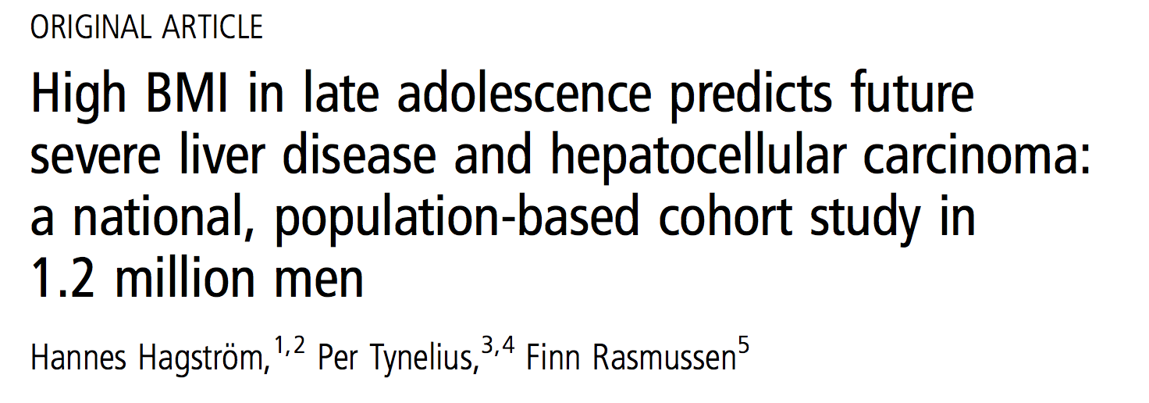
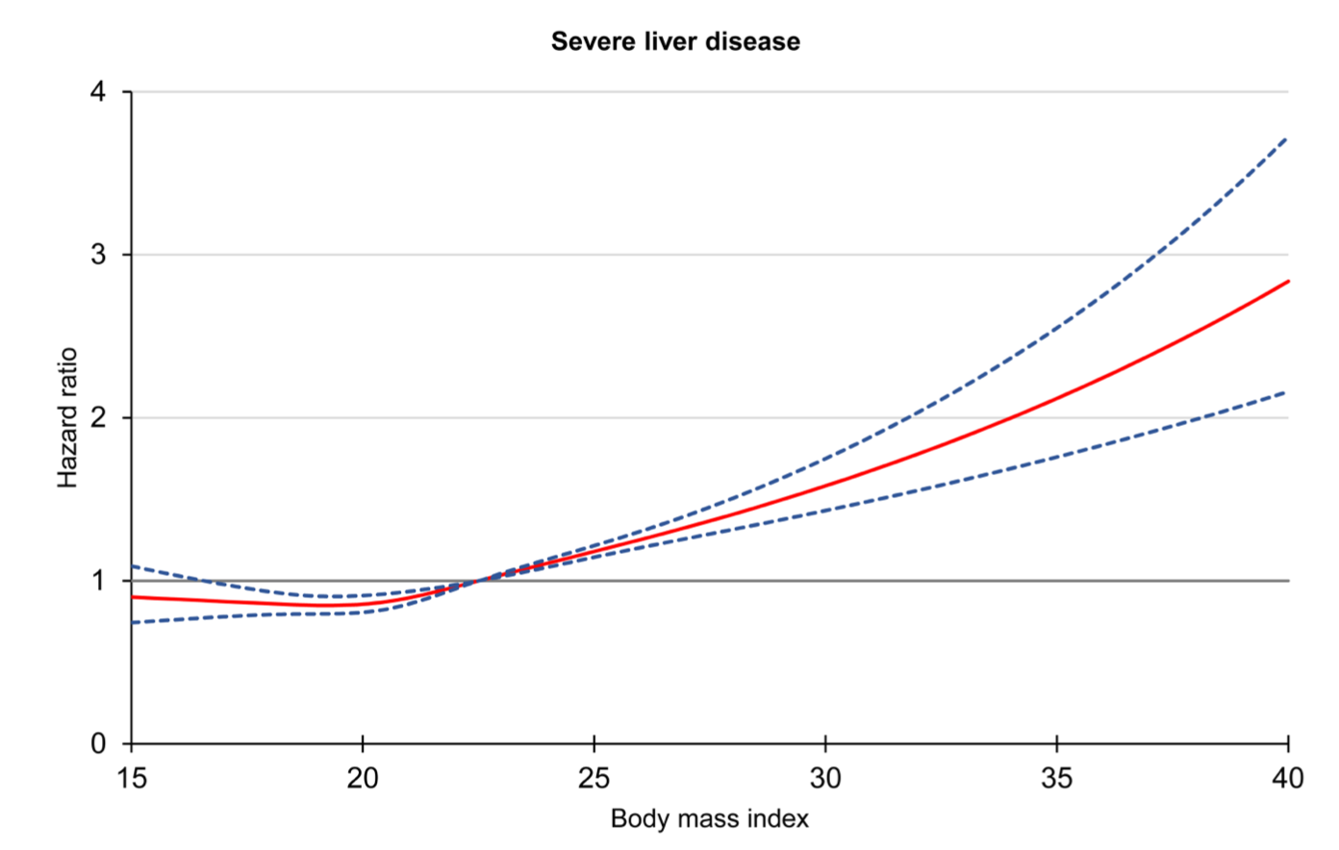
50% increase in risk of liver disease in overweight men vs normal
Those with obesity & T2D more than 3x more likely to develop liver problems than normal weight & no T2D
Conclusion:
A high BMI in adolescent males was associated with increased risk of future severe liver disease
Development of T2D associated with further increased risk

Slide 32
Alignment with peer reviewed source
News article did provide accurate summary… But scientific article gave more detail
Where the data came from
Mandatory conscription allowed 97% Swedish male population from 1969-1996 to be followed
Factors to consider
Population of interest: Swedish, young male, army
Obesity rate at the time
Rate today has tripled since 1975

Slide 33
Public Health Implications
Increasing rates of obesity → increasing rates of liver disease
Increasing rate of T2D exacerbates the problem
Therefore, we need
Interventions targeting obesity and overweight at early age, emphasizing T2D as risk factor for liver disease
Screening of men with T2D for presence of liver disease using noninvasive, inexpensive scoring methods and inform them of their risk of development
Recognizing obesity and T2D as risk factor for liver disease, there is an even greater push to fight against childhood obesity

Slide 34
Discussion Questions
As a public health official, what would you prioritize in order to decrease liver disease?
What advice should a doctor give to a patient who is becoming obese and has a family history of type 2 diabetes?

Slide 35
Obesity and Liver Cancer

Slide 36
Other Obesity-Associated Cancers
Incidence/100,000
4.2
3.2
14.8
8.6
1.4
10.9
167 (F)/1 (M)
8.1
11.7
15.6
209
0.5
0.4
Notes:
Corpus uteri -> Cervical

Slide 37
Mechanisms Linking Obesity to Cancer
Excess energy available for cancer growth
Low level chronic inflammation with obesity
Increased insulin/IGF1 (promotes cancer growth)
Increased estrogen production in adipose tissue (Estrogen dependent tumors)

